Slide 1
DTE-2501
Natural Language Processing
Levenshtein Distance & Term-Frequency Inverse Document Frequency
Andreas Dyrøy Jansson – Phd Candidate, UiT Narvik
Room: C3190
Email: Andreas.d.jansson@uit.no
Shayan Dadman – Phd Candidate, UiT Narvik
Room: D3430
Email: Shayan.dadman@uit.no

Slide 2
More practical applications of NLP
Levenshtein distance for spell checking
Inverse document frequency for keyword extraction

Slide 3
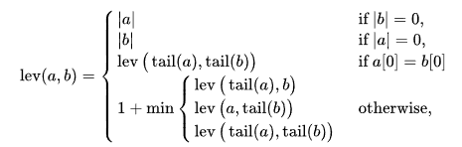
Levenshtein distance I
A way to measure the «edit distance» between two strings
I.e., how many changes do we have to make to go from one string to the other
Insertions, deletions and substitutions

Slide 4
Levenshtein distance II
Example: change survey to surgery
survey -> surgey (substitution of v for g)
surgey -> surgery (insertion of r)
Levenshtein distance = 2
Example 2: change robot to rabbit
robot -> rabot (substitution of o for a)
rabot -> rabbot (insertion of b)
rabbot -> rabbit (substitution of o for i)
Levenshtein distance = 3

Slide 5
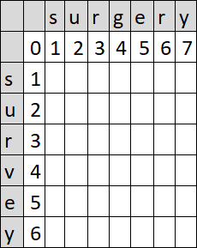
Levenshtein distance III
Can be computed using (tabular) dynamic programming
Wagner–Fischer algorithm
Given two strings, a and b:
Create a matrix of size len(a) + 1 by len(b) + 1
Initialize the matrix with worst-case values
I.e., how many operations must we do to create the strings from nothing?
“” to “” requires 0 changes, “” to “s” = 1, “” to “su” = 2, “” to “sur” = 3
We are interested in the number of changes to go from a to b
“sur” to “sur” requires 0 changes, “surg” to “surv” is 1 change etc.

Slide 6
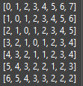
Wagner–Fischer algorithm
Given a = “survey”, b = “surgery”
Initialize d[len(a) + 1][len(b) + 1]
Set row 0 and column 0 to worst-case
FOR every character c in b (j):
FOR every character k in a (i):
IF c = k:
cost is 0
ELSE:
cost is 1
Set d[i][j] = MIN(d[i-1][j]+1, d[i][j-1]+1, d[i-1][j-1]+cost)
The answer is 2 and is found in d[len(a)][len(b)]

Slide 7
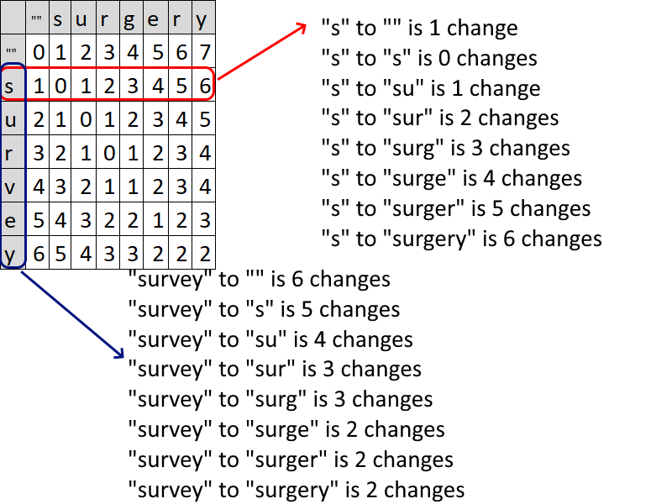
Tabular approach

Slide 8
Spell checking
Levenshtein distance can be used for simple spell checking
Compare input with known words
Suggest word(s) with shortest edit distance
Example:
Dictionary: {halloween, halo, hello, help, home}, {work, world, worth}
Input: hlllo wrold
Compare input to each known word
hlllo [> halloween = 5, > halo = 2, > hello = 1, > help = 3, > home = 4]
wrold [>work = 3, > world = 2, > worth = 4]
We thus conclude that «hello world» is correct and suggest it to the user

Slide 9
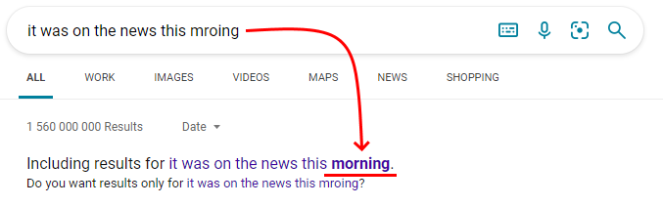
Other practical applications…
Levenshtein distance can also be used for clustering words based on similarity, like any other distance metric
E.g., Euclidean distance etc. in K-NN
Comparing two languages and their intelligibility (linguistics)
lev(“arbeidsplass”, “Arbeitsplatz”) = 3 lev(“arbeidsplass”, “lieu de travail”) = 13
Search engines

Slide 10
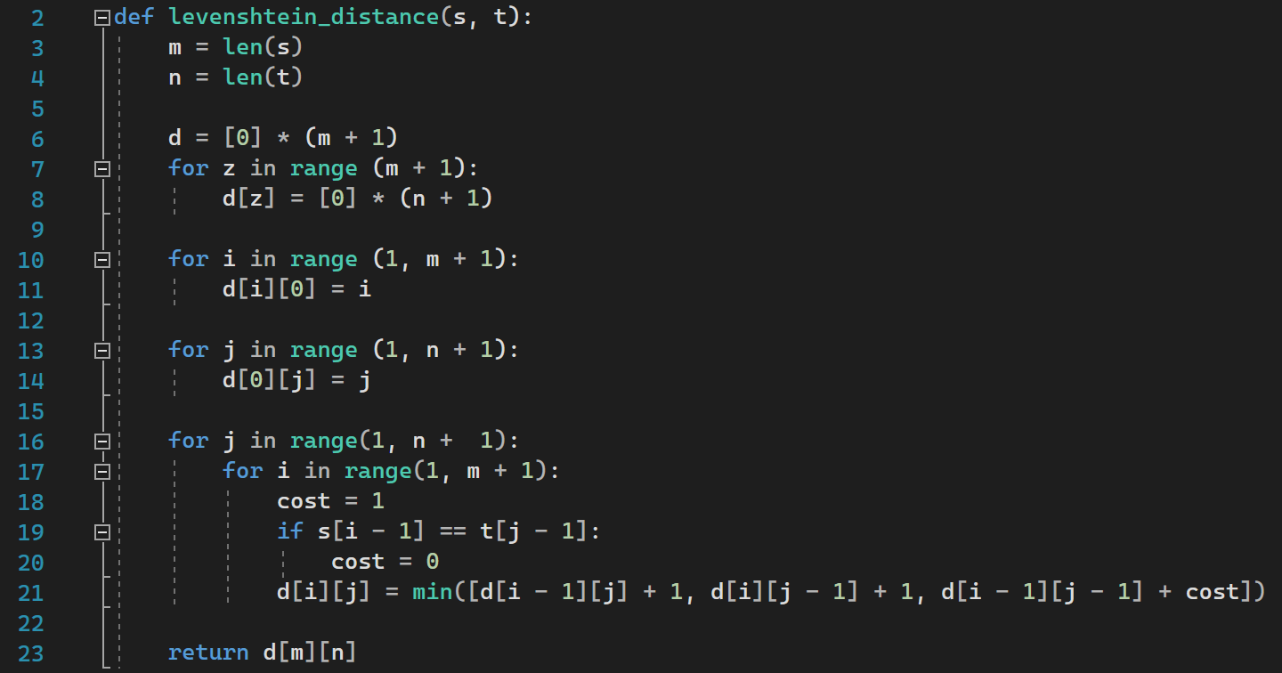
Code

Slide 11
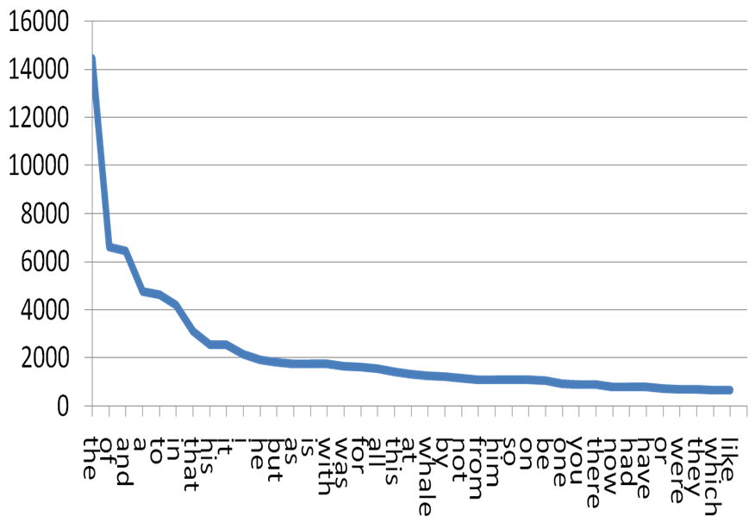
Keyword extraction and information gain
Inverse document frequency
How often does a word appear in a set of texts?
May be used for preprocessing to remove «filler words» automatically
Based on Zipf’s law
This means that the least used words are the most important, or informative
Words like «the, of, and, a, to» and so on add little or no value when looking for meaning in a text
Similarly, if a word is used multiple times in different, unrelated texts, we assume that this word is less important

Slide 12
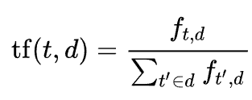
Term frequency–inverse document frequency (TF-IDF) I
Statistic for determining the importance of a word in a document
Based on the number of occurrences per document, compared to all the words in the entire collection of documents (corpus)
Recall Zipf’s law – the less frequent a word is, the more important it is
Term frequency TF is the relative frequency of a word in a single document
$$tf\left(t, d\right)=\frac{number of times word t appears in d}{total number of words in d}$$

Slide 13
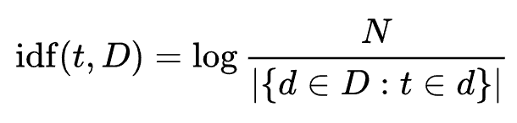

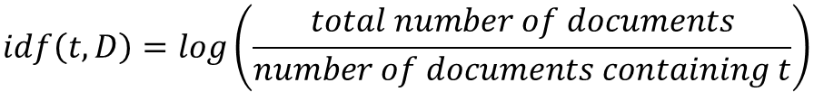
Term frequency–inverse document frequency (TF-IDF) II
Inverse document frequency IDF is a measure of how much information the word provides
If a term t appears in multiple, or even all, documents, we can assume that this word is less important for the meaning of a single document d
Again, based on Zipf’s theory
Combined with TF to form TF-IDF:
$$idf\left(t, D\right)=log\left(\frac{total number of documents}{number of documents containing t}\right)$$

Slide 14
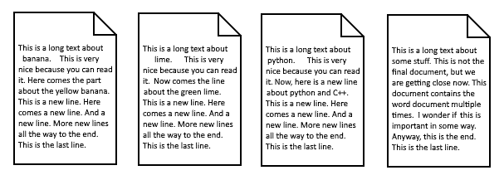
An example:
Corpus – a set of documents containing some text:

Slide 15
The basic concept
We want to find the words that appear often in ONE document – these are probably important to the meaning of THAT document
This is the TF-part
BUT – we want to «filter out» the words that appear often in ALL the documents
These do not add any value, and are most likely filler words
This is the IDF-part

Slide 16
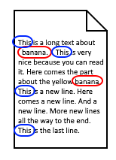
Term Frequency
Count how often every word appears, in each document
Considering the first document:
«banana» only appears 2 times. This means that the Term Frequency is TF = 2/52 = 0.038
«this» appears 4 times, TF = 4/52 = 0.077
Is it more important to the meaning though?

Slide 17
Inverse Document Frequency
This is the LOG-10 of the number of documents in our corpus (4) divided by the number of documents containing the term (word)
«banana» only appears in the first document
IDF = log(4/1) = 0.6
TF-IDF = TF * IDF = 0.038*0.6 = 0.023
«this» appears in all 4 documents
IDF = log(4/4) = log(1) = 0
TF-IDF = TF * IDF = 0.077 * 0 = 0
We can conclude that «this» is a stop word

Slide 18
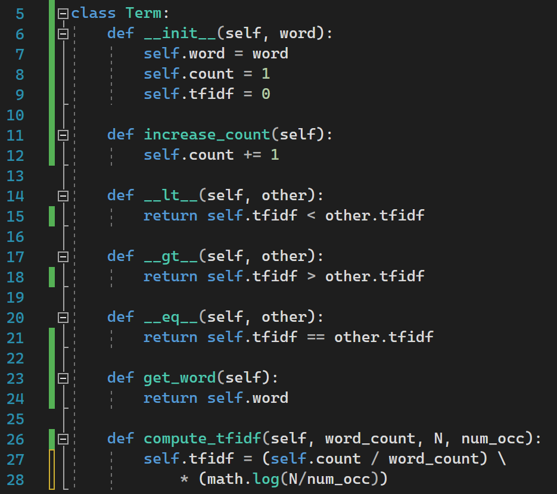
OO-Implementation
A Term-class
Holds the word itself, number of occurrences in its document, and the TF-iDF value
Comparator functions for sorting
A function to compute the TF-IDF

Slide 19
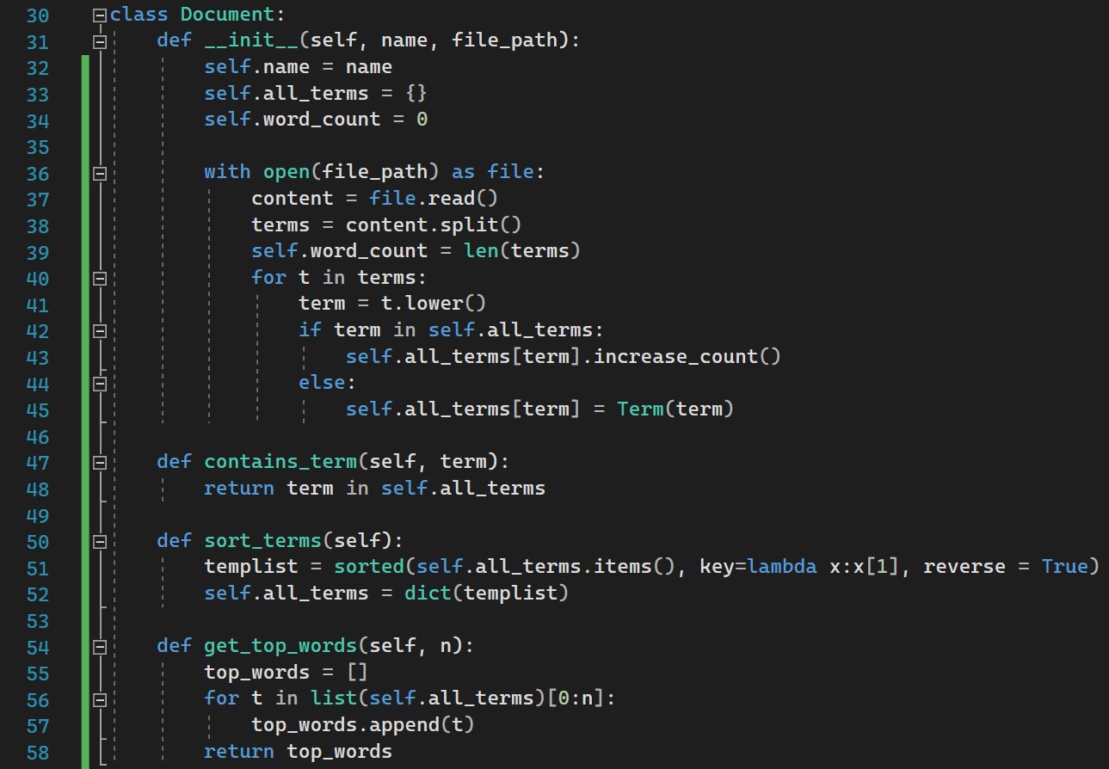
OO-Implementation
A Document-class
Reads the file, and puts each term in a dictionary
*Here is a good place to do preprocessing, like remove punctuations etc.
Count how many times each word appears in the text
Functions for checking if a word is present in the document, sorting, and retrieving the most important words according to TF-IDF

Slide 20
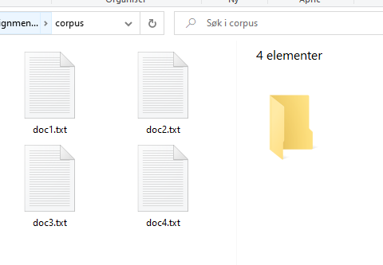
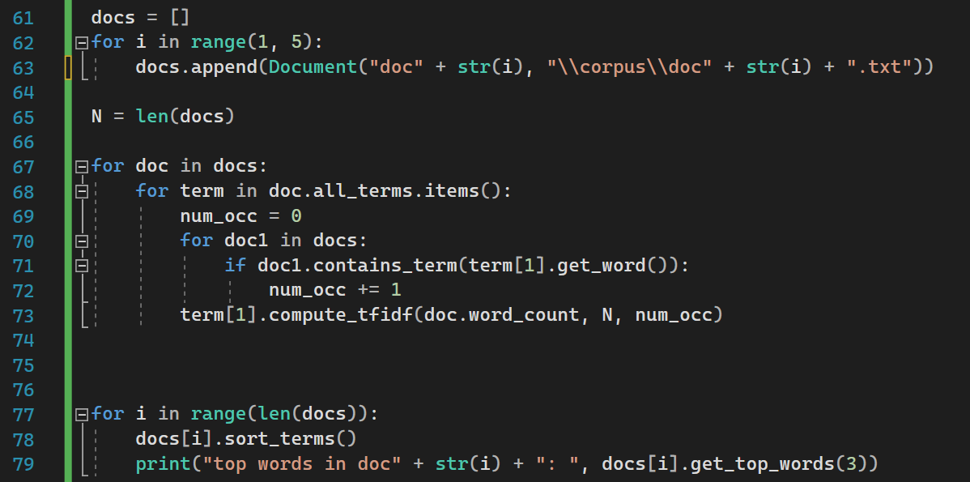
OO-Implementation
Read the files using the Document-class
N = the total number of documents
Loop over all documents
Loop over all terms
Count how many of the documents the current term appears in
Compute the TF-IDF of every term
Sort the terms of each document based on its TF-IDF value
Print out the “most important” words in each document

Slide 21
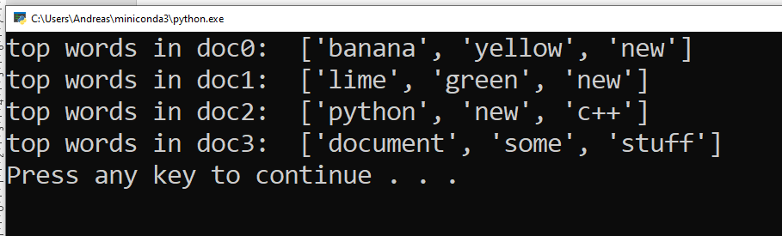
Output

Slide 22
Further reading
The String-to-String Correction Problem (Levenshtein) https://dl.acm.org/doi/pdf/10.1145/321796.321811

